Slide 1
Tabletop Torsion Device
Interim Design Review
By: Brendan Keane, Logan M^{c}Call, Reggie Scott, Mark Swain
Instructor: Dr. Nikhil Gupta
Sponsor: Mr. Philip Flater (Munitions Directorate Eglin AFB) Advisor: Dr. Simone Hruda

Slide 2
Overview
Background with Constraints
DIC
Design Overview
Current Status of Components
Challenges
Budget
Plan of Action
Conclusion
Mark Swain

Slide 3
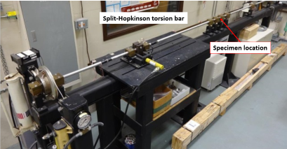
Background with Constraints
Existing test hardware at Eglin AFB is not well-suited for characterizing relatively-small test samples that have been fabricated from plate or bar stock
Maximum torque output: 100Nm
Machine must fit in an area (footprint) of 1m²
Monotonic(one direction) free-end torsion loading
Axial 1 DoF
Compatible with DIC
Budget - $2,000
Figure 2.1: Existing Torsion Machine
Mark Swain
Notes:
The reason for limited plate thickness is not a matter of cost, however it is a matter of geometry. When the Munitions Directorate is fabricating components of the munitions they use raw stock that is as close to final shape as possible to conserve waste material. In order to properly characterize the materials that end up in a product they have to simply test similar geometry in order the get accurate results.

Slide 4
DIC (Digital Image Correlation)
Figure 3.1 DIC setup at Eglin AFRL
Figure 3.2 Example DIC use in torsion sample
“DISTRIBUTION A: Approved for public release, distribution unlimited. (96ABW-2014-1649)”
Mark Swain

Slide 5
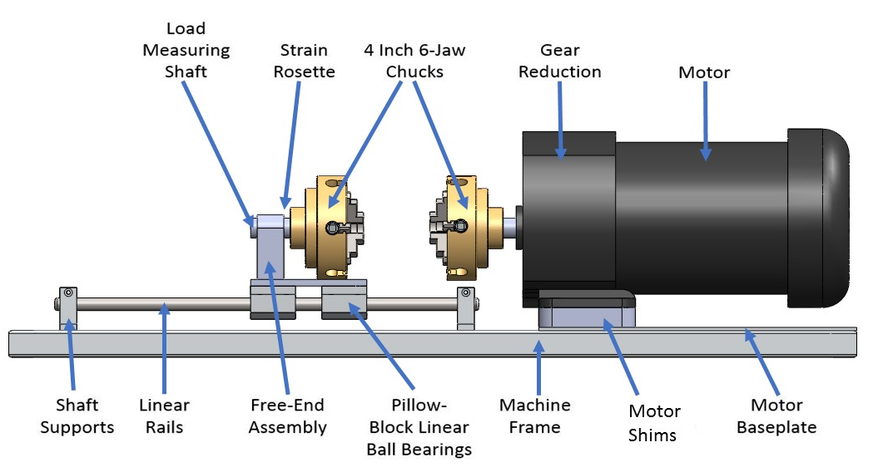
Design Overview
13”
Steel Shaft
Figure 5.1: CAD representation of design
32”
Mark Swain

Slide 6
Load Generation: AC Gearmotor
Vendor: Grainger
Rpm: 18
Gear ratio: 95:1
Max torque: 116 Nm
Weight: 26 lbs
Figure 5.1: AC Gearmotor
Mark Swain

Slide 7
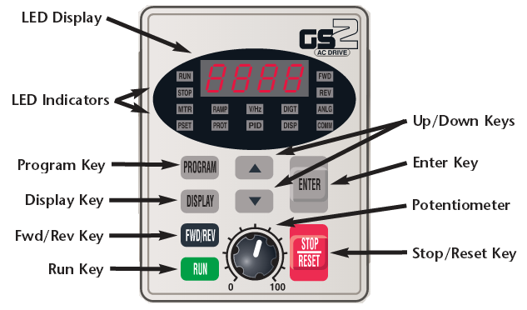
Motor Control
Variable Frequency Drive (VFD)
Vendor: Automation Direct
Single phase input, three phase output
Digital keypad
Forward and reverse
Expandable
Figure 6.1: VFD keypad
Mark Swain

Slide 8
Motor Testing
Testing the interface between motor and VFD
Currently capabilities
Forward and reverse motion by button press
RPM/Torque control
Desired capabilities
Set specific shaft rotation
Figure 7.1: Testing of motor and VFD capabilities
Mark Swain

Slide 9
VFD Parameter Selection
Example: Input motor base RPM
Select parameter group P0.00 [Program]
Select setting P0.03[Enter]
Set motor RPM [Enter]
Figure 8.1: VFD parameter selection flow
Mark Swain

Slide 10
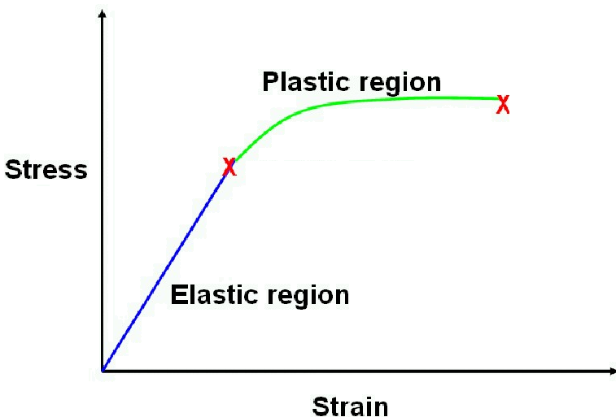
Load Measurement
Measuring components provided by AFRL
DIC
Strain gauges
Coupler material: Al 6061
Shaft properties
Shear modulus: 26 GPa
Shear strength: 76 MPa
Length: 7.6 cm
Diameter: 1.9 cm
Expected shear stress for
Al 2024: 29.5 MPa
Titanium: 51.5 MPa
G = $\frac{τ}{γ}$
Figure 9.1: Stress vs. strain plot showing the shear modulus relationship
Mark Swain

Slide 11
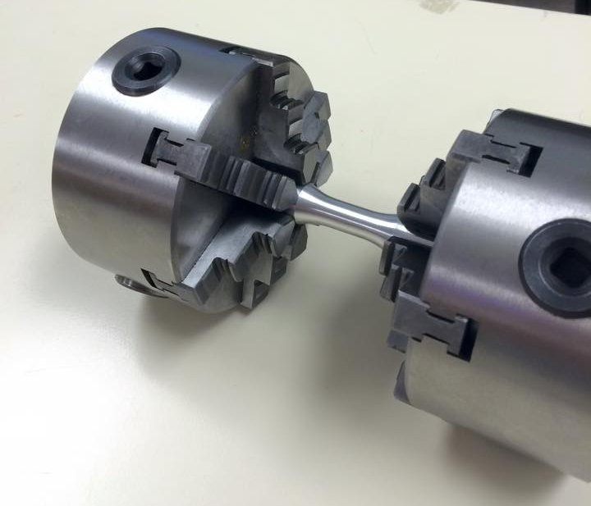
Load Application: 6-Jaw Chuck
Vendor: LittleMachineShop
Weight: 6.4 lbs
Outer diameter: 3.94 in
Inner diameter: 1.02 in
Figure 10.1: 6 Jaw Chucks holding specimen
Reginald Scott

Slide 12
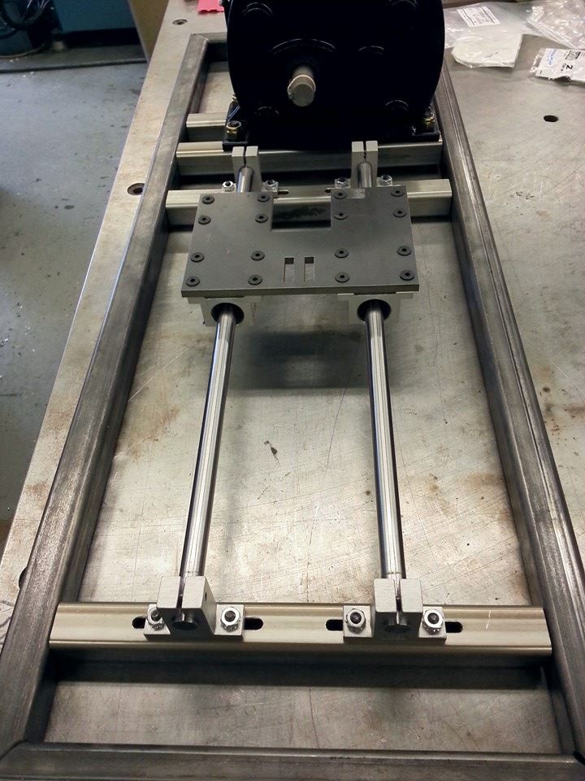
Linear Motion: 2 Rail Ball Bearing Guide
Vendor: Grainger
½ inch Steel rails
Slot design to ensure alignment
Figure 11.1: Linear guide system
Reginald Scott

Slide 13
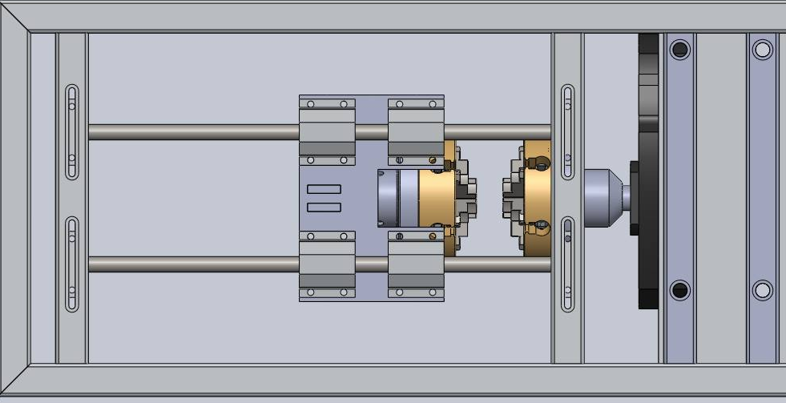
Housing Design
Steel frame and housing
Shape: hollow square shaped cross-section
Frame dimensions:
1/8 in inner supports – 304 stainless steel
1/8 in outer frame - low carbon 1015 steel
Figure 12.1: CAD drawing of frame (bottom view)
Reginald Scott

Slide 14
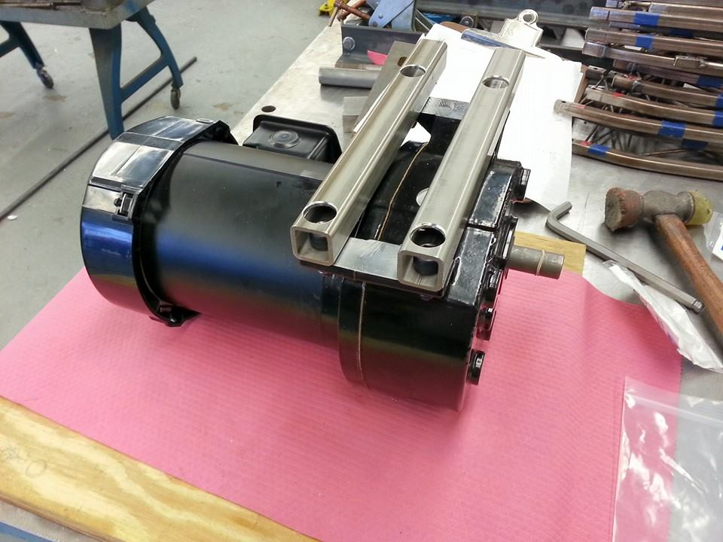
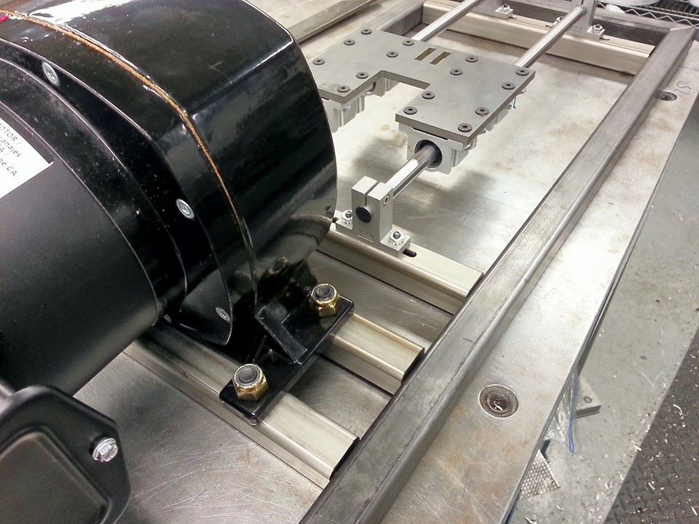
Machining Progress
Figure 13.1: Motor shims and connectors
Figure 13.2: Preassembly without welds
Reginald Scott

Slide 15
Challenges
Budget
Motor Control
Learning how to use a VFD
Assembly Issues
Difficulties in machining/assembling
Sponsor Communication
Scheduling conflicts due to more pressing matters
Delivery of critical components (i.e. coupler material)
Reginald Scott

Slide 16
Budget
Budget: $2,000
Spent: $1,839
Net: + $161
Reginald Scott

Slide 17
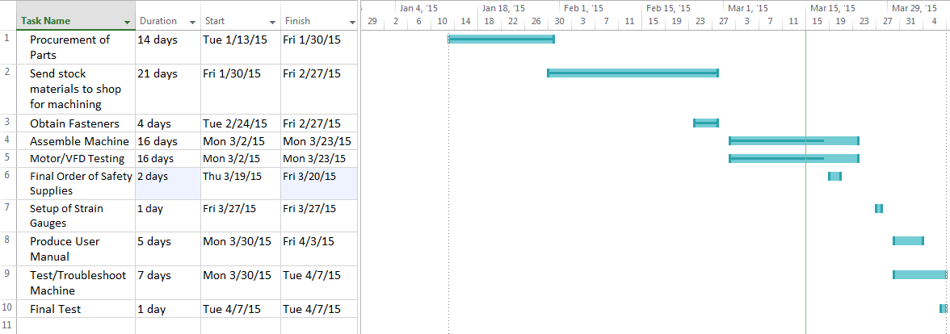
Plan of Action
Reginald Scott

Slide 18
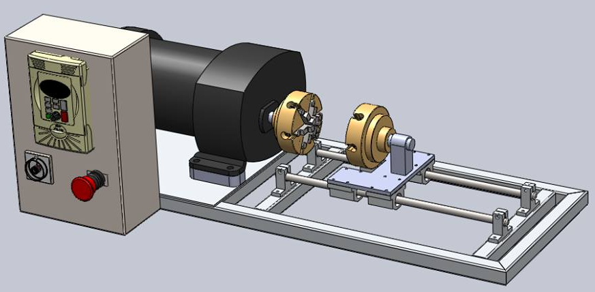
Conclusion
Goal Statement
Design a more effective way of testing small specimens in free-end torsion.
Next Phase
Assemble (welding)
Testing
Eglin visit for strain gauge placement
Figure 17.1: Design slated for production
Reginald Scott
Notes:
Completion of initial design sketches- Preliminary calculations- Design selection for full CAD build- Full CAD build

Slide 19
Questions?

Slide 20
References
Carter, B. (2008). Texas Instruments: Op Amp Noise Theory and Applications. Retrieved September 22, 2014
Flater, P. (2014). Tabletop Torsion Test. Eglin, FL: Air Force Research Laboratory.
Ilic, M. (2014, October 11). Clamp for centering. Retrieved from GRABCAD: https://grabcad.com/library/stega-za-centriranje-clamp-for-centering-1
Lathe Chuck. (2014, October 7). Retrieved from GRABCAD: https://grabcad.com/library/lathe-chuck-3
Linear Motion Systems. (2014, September 28). Retrieved from Stock Drive Products: https://sdp-si.com/eStore/coverpg/linearmotion.htm
http://www.centuryspring.com/info/spring_measurement.php - spring picture
Mark Swain

Slide 21
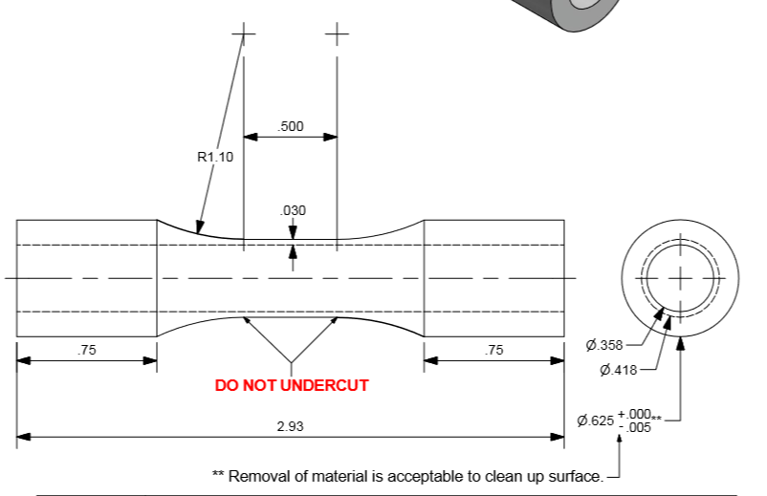
Specimen Dimensions
Brendan Keane

Slide 22
Appendix

Slide 23
